Slide 1




Publishing Requirements from Caliber to QC and
Instructions for Change Requests - Burgundy
Xiao Yan (Kylie) Oct 2009
© 2004 Hewlett-Packard Development Company, L.P. The information contained herein is subject to change without notice

Slide 2
Burgundy specifics

Slide 3
Burgundy Specifics
Most of this training applies to all Burgundy projects
Some specifics apply only to the Wave 2 project, since it has many sub-projects – we will make clear when training applies only to Wave 2 projects
Both Wave 2 and Wave 1 Fallout use IT Tracking #’s instead of the Caliber-generated BR#s
Do not publish to Quality Center until you have the go-ahead from Zatorski, Steven J. (or Diana Murelaga)
Rationale: Avoid need to re-publish unnecessarily
Where are BRs and PRs
Business Requirements: are in PSGIT_Tier1 Caliber Project
Assets’ Product Requirements:
The master must be in the Asset’s Caliber Project
Must be published to PSGIT_Tier1 Quality Center, and the ones in QC are only copies

Slide 4
Burgundy Specifics
How to apply for an asset Caliber project instance
Submit a TPM package request, following the instruction below
http://intranet.hp.com/HPIT/ITALM/Pages/IT_Platform.aspx
How to apply for access to a Business/IT Caliber
Use CART following these instructions: http://itsupport.hp.com/portal/site/sg/documentdetail?docid=KM025911
PSGIT_Tier1 Business Caliber information
Server: crm-01.atlanta.hp.com:20000
Project: PSGIT_Tier1
IT Asset Caliber information : contact IT Project Manager
How to apply for access to PSGIT_Tier1 QC
Submit Request here: http://enhanced2.sharepoint.hp.com/teams/WWECOReleaseMgt/Lists/Submit%20Request%20for%20Access%20to%20Caliber%20and%20Quality%20C/AllItems.aspx

Slide 5
Burgundy Specifics
PSGIT_Tier1 QC has been upgraded to a new version10
New Link : http://qc1b.atlanta.hp.com/qcbin/start_a.htm
new login: john.doe_hp.com (“_” instead of “@”)
Some Content in PR description can be accepted by Caliber but not by QC
Snapshot will show {Image: DE35DFF0-5A70-4120-92D0-C20590669806.bmp} instead of visible picture once published to QC
Tables will lose format, each cell will turn into a line
The master for the PR is still in the Product Caliber

Slide 6
Burgundy Specifics
When can’t publish
If there is no “Publish to Quality Center” option under “Tool” tab
Submit ticket to PD&E if your caliber is on crm-01.atlanta.hp.com
http://itsupport.hp.com/portal/site/sg/documentdetail?docid=KM024299
Or contact your own Caliber Admin
If you are not PD role in PSGIT QC or see error message saying that you don't have permissions to publish during process
View your QC Access request on SP:
http://enhanced2.sharepoint.hp.com/teams/WWECOReleaseMgt/Lists/Submit%20Request%20for%20Access%20to%20Caliber%20and%20Quality%20C/MyAccessRequest.aspx
If needed, log a new a request to change your existing QC role to PD

Slide 7
Burgundy Specifics
When Publish/re-publish fails
Make sure no QC user with edit permission is editing the copies in QC (no one should be editing requirements in QC)
Try again after removing special characters/formats in the requirement description in Caliber.
Special Characters E.g. “:!$-@#%^&()*’
You may notice that some PRs are published successfully with these characters when other PRs fail.
Use the Bullet and Numbering in Caliber instead of the ones in Word or other tool
You may notice that some PRs are published successfully using Word formatting when other PRs fail.
Make sure the requirement type for the copies in QC are “Undefined”

Slide 8
Agenda

Slide 9
Course topics
How to organize your PRs and Test Reqts during Design
Hierarchy in Caliber so as to ease publishing to QC
Publishing:
Preparation before Publishing
Publish New Requirements to QC
Change Requests:
Process Approved CR to Add More New Requirements to Caliber then QC
Process Approved CR to Republish Modified Requirements to Caliber then QC
Process Approved CR to Remove Requirements from Caliber & QC
Other Tips or Concerns

Slide 10
Organizing your Product & Test Requirements

Slide 11
Organizing Hierarchy
Asset Caliber: All asset PRs or Test Reqts
Organize them under your project name (e.g. Wave 2) in Asset Caliber
not required to be grouped by W2-project
Include the Business Requirement tracking number (“IT Tracking No” for Wave 2 and Wave 1 Fallout) in the requirement name.
May be multiple
Use comma with no space between multiple Business Requirement tracking number ( or “IT Tracking No” for Wave 2/W1F)
Example: 75-123,89-106,BR106109 Shopping Cart Page
Test requirements start with ‘Test Only’
Example: Test Only 49-123 create an order
See examples in following slides
Release level QC: All asset PRs or Test Reqts
Publish requirements under your project name (e.g. Wave 2) under your asset folder

Slide 12
Organizing Hierarchy – Caliber example
IT3 Product Requirements (Asset 1’s project)
Burgundy
PPM125663 Customer Master Data Phase 1
BR105101 – label of PR
PPM124078 ePrime PA-RISC Exit 2
BR106109 – label of PR
PPM169957 ESD Phase 3A
BR107102 – label of PR
PPM130499 Wave 1 Simple Fallout Project
W1F-P02 Automated Credit Card Processing
PPM127105 Wave 2
Overview
Non Functional Requirements
49-611 Return search result within 3 sec
No degradation in security
Functional Requirements
75-123,89-106,BR106109 Shopping Cart Page
27-602 Continue shopping in PSC
39-662 CRS ID
Test Only 25-449 multi-lingual tool for telesales
Test Only 25-450 localized content on store
…..
Legend:
Blue – optional for publishing
Black – required (any PR that traces to a BR)

Slide 13
Organization of Product Requirements (ADD) in Product Caliber
Product name (derived from CI Logical Name per PD&E package request)
Name of release
PPM Project Request Number and Project Name
Pre-populated fixed folder names shown in black bold
PRODUCT_RELEASE
IT3 Product Requirements (PR)
PPMid1 Project Name 1 (PPM127105** Wave 2)
BR 1 id*(use IT Tracking no. from BRD) – PR 1 label
BR 1 id* – PR 2 label
Group A
BR 3 id – PR 3 label
BR 3 id – PR 4 label
PPMid2 Project Name 2
BR 6 id – PR 5 label
IT4 Technical Requirements (TR)
(follows product implementation)
Focus of the Product Design Phase
Optional business requirement grouping
*Note: For Wave 2 and W1F, use IT Tracking number versus Caliber generated BR ID (for new requirements, use the BR ID). If one PR is applicable to multiple BR’s, list all applicable IT tracking numbers/BR IDs - this can be after PR Label. Use a comma with no space in between multiple BR ID or IT Tracking No. E.g. 75-123,89-106,BR106109 Shopping Cart Page **Note: For Wave 2, use only PPM 127105 for Caliber and QC To create Test Only requirements in Caliber for leverage requirements, use the naming convention “Test Only IT Tracking number (or BR ID) PR1 label”
The Tools Package Request process sets the structure of Caliber projects
If a release uses a “Business Caliber project” then Caliber projects for each product:
do not have BRs and UCs (as above)
else
include BRs and UCs (with PRs and TRs)
Coordinate with your L2 DLC rep on the appropriate package request for your release.

Slide 14
Organizing Hierarchy – QC Example
Burgundy
130499 Wave 1 Simple Fallout
127105 Wave 2
Fusion EMEA
40-111 Order Status – PR 105108
Test Only 81-522 Return – PR 105109
ISCS
27-602 Continue shopping in PSC – PR 105107
39-662 CRS ID – PR 105108
Test Only 25-449 multi-lingual tool for telesales – PR 105109
Test Only 25-450 localized content on store – PR 105110
Asset ….
125663 Customer Master Data Phase 1
124078 ePrime PA-RISC Exit 2
169957 ESD Phase 3A
Note: An Asset can have a hierarchy within their requirements, within a PPM project. We will manage to the lowest level of requirements in the hierarchy.

Slide 15
Preparation before Publishing

Slide 16
Preparation before Publishing
Install Quality Center Connectivity Add-in
You MUST perform this step prior to attempting to publish requirements from CaliberRM to QC
Go to this URL: http://qc1b.atlanta.hp.com/qcbin/
Click on Add-ins Page
Click on the HP Quality Center Connectivity link
Click on the Download Add-in link
Click on Run
Click on Run (again)
Click OK

Slide 17
Preparation before Publishing
2. Check QC Permissions
In order to publish requirements to PSGIT_Tier1QC you must have a Product Definer role in the QC project
Find QC access request here:http://enhanced2.sharepoint.hp.com/teams/WWECOReleaseMgt/Lists/Submit%20Request%20for%20Access%20to%20Caliber%20and%20Quality%20C/MyAccessRequest.aspx
Check Caliber Requirements
Confirm the Hierarchy of the requirements : product requirements with different hierarchies are allowed but the structure in Caliber will determine how they will look like in QC, so please make sure the hierarchy in Caliber is correct. If needed, check with Kylie or Diana/Linda.
Confirm the name, description, CaliberRM Status, CaliberRM Owner : these values will be published to QC together with other auto ID/version etc

Slide 18
Publish New Requirements to QC

Slide 19
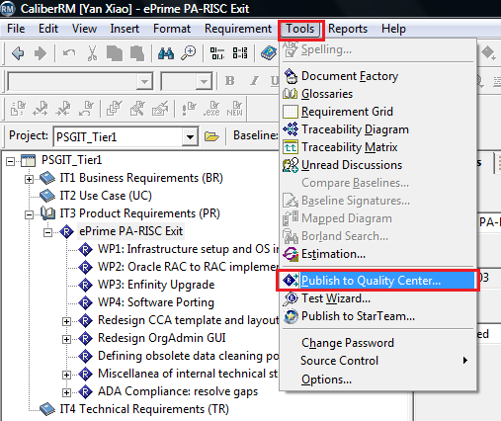
Publish New Requirements to QC
In CaliberRM, Go to Tools →Publish to Quality Center
This could take a few minutes. Please wait till a new pop up window is displayed, called ‘Select Requirements To Import’
ePrime
ePrime

Slide 20
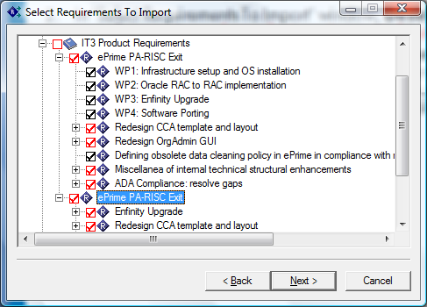
Publish New Requirements to QC
In ‘Select Requirements To Import’ window, Deselect all requirements: only product requirements and test requirements should be published to QC
Select all product and test requirements for one project only such as for Wave 2. If you want to publish requirements for Wave 1 Fallout, for example, please repeat slide No. 15 to 23, because they need to be stored in a different folder in QC.
Click Next

Slide 21
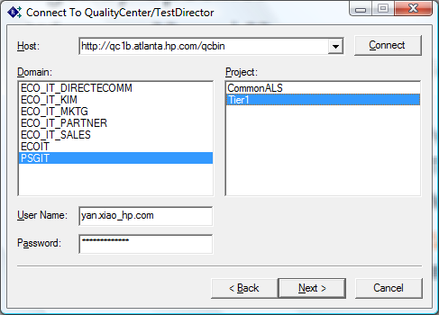
Publish New Requirements to QC
5. In ‘Connect To QualityCenter/TestDirect’ window, select Host :http://qc1b.atlanta.hp.com/qcbin/
6. Enter your QC user name and password then click Connect
7. Select QC Domain PSGIT then select project Tier1
8. Click Next
Note:
If you are not in the proper QC group with permissions to create/modify requirements you will be told that you don't have permissions to publish.
If you don’t see this QC URL in step 5, please contact your Caliber admin to add it.

Slide 22
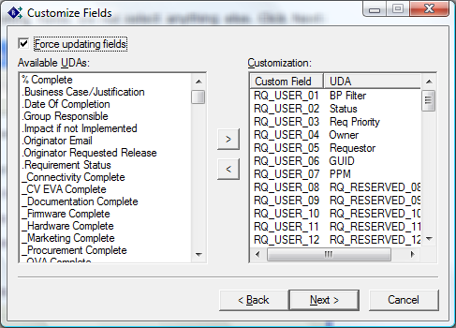
Publish New Requirements to QC
9. In ‘Customize Fields’ window, Select force updating fields. Do not select anything else.
Click Next

Slide 23
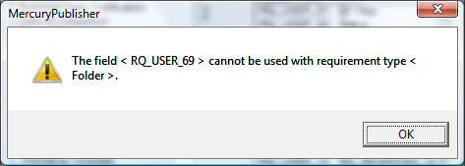
Publish New Requirements to QC
11. If you see a window similar to this that has the word "< Folder >" in it you may ignore this message. Click OK and continue.

Slide 24
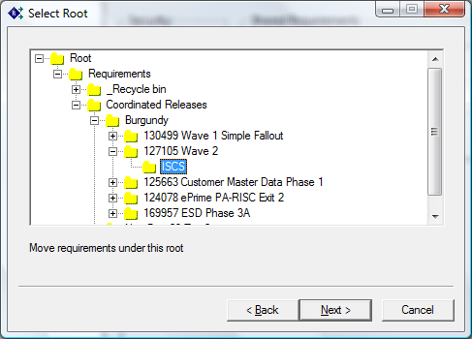
Publish New Requirements to QC
Expand the Root tree to the correct location to publish requirements
To find the project’s version of the asset’s folder in PSGIT QC: e.g. Go Root →Requirements → Coordinated Releases → Burgundy→ 127105 Wave 2 →ISCS
Then Highlight the asset folder e.g. ISCS folder, click Next
Note: make sure the
asset folder is set up
before your publish

Slide 25
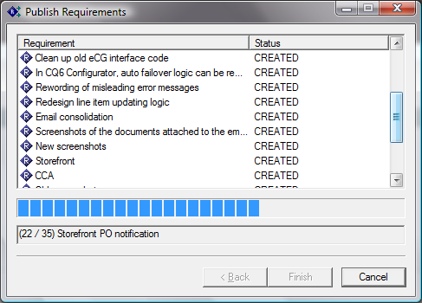
Publish New Requirements to QC
When the system is processing the publish request, it could take a lot of time. Since this is the first time to publish these requirements, they will be marked as “CREATED” when they are published successfully.
Please wait until the process is finished, and the ‘Cancel’ button will be changed to ‘Done’, then click ‘Done’. Now we are finished.

Slide 26
Publish New Requirements to QC
We have finished the publishing steps in Caliber. Please login to QC and Leave/Make Sure Requirement Type in QC = Undefined, unless a node is not the lowest level of requirement - then change the requirement type to folder. Due to a limitation in the Borland publishing tool, it is imperative that you do not change the requirement type of the QC requirements that were published from CaliberRM. They must remain as Undefined requirement types. If you change the requirement type in QC, this will cause errors in subsequent attempts to publish requirements from CaliberRM to QC. Once the type is changed, you may not be able to republish the updates successfully.

Slide 27
Publish New Requirements to QC
Manually enter the following fields in QC per SLIM (see highlighted in red in next slide)
PPM field:
125663 Customer Master Data Phase 1
124078 ePrime PA-RISC Exit 2
169957 ESD Phase 3A
168504 Public Sector Data Completeness Phase 2
130499 Wave 1 Simple Fallout Project
127105 Wave 2
Target Release = Burgundy
Product : select asset
If node is not the lowest level of requirement, then change the requirement type to folder.
Note that the following fields will also be loaded in QC by Release Management (see highlighted in yellow in next slide)
Focus Area: region impact
Category: required for W2-projects only, multi-select
Please don’t change other fields, especially the blue fields highlighted in next slides (unless you have to change a reqt type to folder).

Slide 28
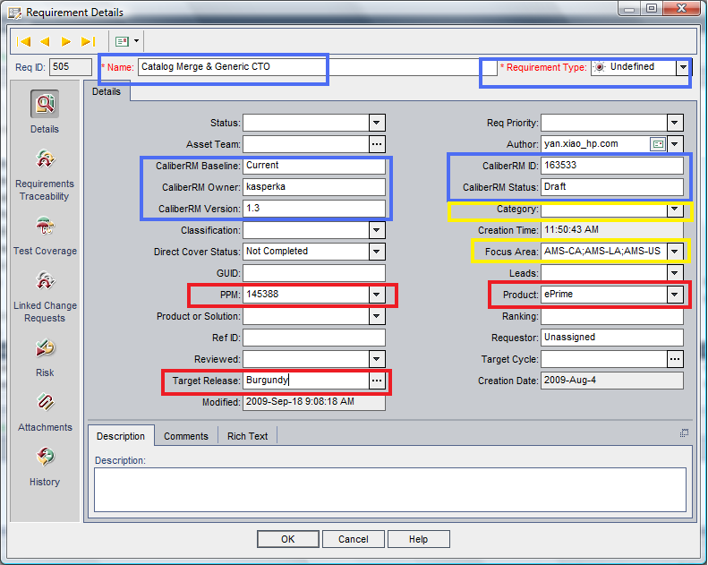

Slide 29
Process Approved CR to add More New Product / Test Requirements to Caliber & then QC

Slide 30
CR approved to Add More New Product/Test Requirements to your Product Caliber
You can publish more new requirements only due to an approved CR. Once the CR gets approved, please:
Ensure Release Management has updated the existing BR or loaded the new BR in PSGIT Tier1 Caliber under the proper project.
For existing BRs, they will:
Add the CR number to the title (E.g. ’73-172 – title – CR 82’)
Add the CR details to the Caliber BR details
For new BRs, they will:
Place the BR and CR number in the title. (E.g. ‘Caliber BR# – title – CR ID)
Add the CR details to the Caliber BR details
Create your Product and/or Test Requirement in your product CaliberRM
Create your new Requirement(s) and trace them to the correct BRs.
Put the IT Tracking #(s) or the BR#(s) from the BR title(s) into the PR title
Place the CR number in the Details

Slide 31
Add More New Requirements to QC
Once Caliber is updated, please:
In CaliberRM, Go to Tools →Publish to Quality Center
This could take a few minutes, please wait until a new pop up window is displayed, called ‘Select Requirements To Import’
ePrime
ePrime
ePrime
ePrime

Slide 32
Add More New Requirements to QC
In ‘Select Requirements To Import’ window, Deselect all requirements: only product requirements and testing only requirements should be published to QC
Focus on the new requirements for one project only such as Wave 2. Repeat for each project with new requirements. Check that the parent requirement(s) for your new requirements are in QC already.
Note: If the parent requirements are not in QC, please publish the parents first. Otherwise the new requirements selected will be published right under your asset folder in QC, and not following the hierarchy in Caliber. As long as the parents of the new requirements are in QC, you do not select them for publishing, yet QC will show the same hierarchy as in Caliber.
(a) If new reqt has child requirement(s): Select the new requirement and its child requirements. The new requirement and its child requirement(s) will be published to QC.
Note: Caliber doesn’t allow publishing the parent without selecting child requirements.
(b) If new reqt has no child requirement(s): Select the new requirements
Please see the examples in the next two slides.

Slide 33
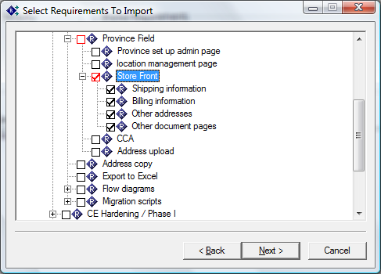
Example Snapshot
Example (a) to publish a new requirement ‘Store Front’ which has child requirement(s), you need to select the new requirement and all its child requirements (so all children will publish into QC)
Suppose requirement ‘Store Front’ is a newly added requirement, now we need to publish it to QC.
Make sure ‘Province Field’ which is the parent of ‘Store Front’ is in QC already
Select ‘Store Front’ - all child requirements (e.g. ‘Shipping information’, ‘Billing Information, …) will be selected automatically as well
Note:
All the parent nodes of ‘Store
Front’ need to be in QC already.
So, if there is a parent of ‘Province
Field’, also make sure it is in
QC. And, same for the parent of
the parent of ‘Province Field’ ….

Slide 34
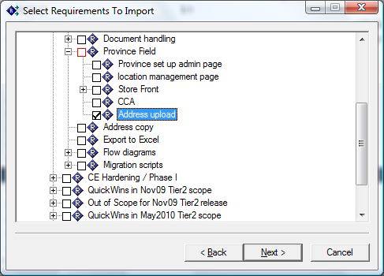
Example Snapshot
Example (b) to publish a new requirement ‘Address upload’ which has NO child requirements
Suppose requirement ‘Address upload’ is a newly added requirement, now we need to publish it to QC.
Make sure ‘Province Field’ which is the parent of ‘Address upload’ is in QC already
Since requirement ‘Address upload’ doesn’t have any child requirements, select the requirement ‘Address upload’
Note:
All the parent nodes of ‘Address upload’ need to be in QC already.
So, if there is a parent of ‘Province
Field’, also make sure it is in
QC. And, same for the parent of
the parent of ‘Province Field’ ….

Slide 35
Add More New Requirements to QC
5. In ‘Connect To QualityCenter/TestDirect’ window, select Host :http://qc1b.atlanta.hp.com/qcbin/
6. Enter your QC user name and password then click Connect
7. Select QC Domain PSGIT then select project Tier1
8. Click Next
Note:
If you are not in the proper QC group with permissions to create/modify requirements you will be told that you don't have permissions to publish.
If you don’t see this QC URL in step 5, please contact your Caliber admin to add it.

Slide 36
Add More New Requirements to QC
9. In ‘Customize Fields’ window, Select Force updating fields. Do not select anything else.
Click Next

Slide 37
Add More New Requirements to QC
11. If you see a window similar to this that has the word "< Folder >" in it you may ignore this message. Click OK and continue.

Slide 38
Add More New Requirements to QC
Expand the Root tree to the correct location to publish requirements
To find project’s version of the asset’s folder in PSGIT QC: e.g. Go Root →Requirements → Coordinated Releases → Burgundy→127105 Wave 2 →ISCS
Then Highlight the asset folder e.g. ISCS folder, click Next. Make sure to select the same folder in QC that contains the other product requirements for that project.

Slide 39
Add More New Requirements to QC
When the system is processing the publish request, it could take a lot of time. Since this is the first time to publish these requirements, they will be marked as “CREATED” when they are published successfully.
Please wait until the process is finished, and the ‘Cancel’ button will be changed to ‘Done’, then click ‘Done’. Now we are finished.

Slide 40
Add More New Requirements to QC
We have finished the publishing steps in Caliber. Please login to QC and Leave/Make Sure Requirement Type in QC = Undefined, unless a node is not a the lowest level of requirement - then change the requirement type to folder. Due to a limitation in the Borland publishing tool, it is imperative that you do not change the requirement type of the QC requirements that were published from CaliberRM. They must remain as Undefined requirement types. If you change the requirement type in QC, this will cause errors in subsequent attempts to publish requirements from CaliberRM to QC. Once the type is changed, you may not be able to republish the updates successfully.

Slide 41
Add More New Requirements to QC
Manually enter the following fields in QC per SLIM (see highlighted in red in next slide)
PPM field:
125663 Customer Master Data Phase 1
124078 ePrime PA-RISC Exit 2
169957 ESD Phase 3A
168504 Public Sector Data Completeness Phase 2
130499 Wave 1 Simple Fallout Project
127105 Wave 2
Target Release = Burgundy
Product : select asset
If node is not the lowest level of requirement, then change the requirement type to folder.
Note that the following fields will also be loaded in QC by Release Management (see highlighted in yellow in next slide)
Focus Area: region impact
Category: required for W2-projects only, multi-select
Please don’t change other fields, especially the blue fields highlighted in next slides (unless you have to change a reqt type to folder).

Slide 43
Process Approved CR to modify & republish Modified Product / Test Requirements to Caliber & then QC

Slide 44
Republishing - Overview
If you need to republish, you need to update the Caliber master first (the one which was published to QC) and then update the QC copy by publishing the master PR from Caliber to QC again. Then the QC copy will reflect the changes.
DO NOT break the traceability between QC and Caliber or remove the older QC copy and try to create a new copy
You will have problems with this approach.
During the republishing process please follow the instructions in the next slides, so that you can be careful with:
the selected Caliber requirements
the selected QC folder
some values in QC

Slide 45
CR Approved to Modify Product/Test Requirements in Product Caliber
You can modify requirements only due to an approved CR. Once the CR gets approved, please:
Ensure Release Management has updated the existing BR (if update needed) or loaded the new BR in PSGIT Tier1 Caliber under the proper project.
For existing BRs, RMT will:
Add the CR number to the title (E.g. ’73-172 – title - CR82’)
Add the CR details to the Caliber BR details
For new BRs, RMT will:
Place the CR number in the title. (E.g. ‘Caliber BR# – title – CR ID)
Add the CR details to the Caliber BR details
Modify your Product and/or Test Requirement in your asset CaliberRM,
Modify your requirement(s) and trace them to the correct BRs.
Put the IT Tracking #(s) or the BR#(s) from the BR title(s) into the PR title
Place the CR number in the Details

Slide 46
Before Republishing Modified Requirements
If you need to change a requirement due to a CR, then you will need to make note of the extra fields of data we populated in QC for the reqt, before publishing the modified PR or Test reqt.
PPM ID
Target Release
Product
Focus Area
Category
To be safe, please note down the values of all the fields above that were manually entered in QC, especially the Category field before doing the republish, so as to compare and double check after the republish is done.
If the modified requirement has child requirements (even if they are unchanged), Caliber will require you to republish one child in order to republish the parent. Note down the field values for that child requirement.
During experiments, all the manually inputted fields were kept after re-publishing, except the Category field.
You will need to re-input or select any over-written fields from above. Specifically, you need to select Category again after publishing.
Requirement Name and Description will be overwritten according to Caliber.

Slide 47
Republish Modified Product/Test Requirements to QC
Once Caliber is updated and ready for the republish, please:
Check QC to make sure the modified requirements are not Requirement Type ‘Folder’. If so, change the requirement type in QC from ‘Folder’ to ‘Undefined’. (Only ‘Undefined’ requirements can be republished successfully).
In CaliberRM, Go to Tools →Publish to Quality Center
This could take a few minutes, please wait till a new pop up window is displayed, called ‘Select Requirements To Import’
ePrime
ePrime

Slide 48
Republish Modified Requirements
In ‘Select Requirements To Import’ window, Deselect all requirements: only product requirements and testing only requirements should be published to QC
(a) If the modified reqt has child requirement(s): Select the modified requirement and at least one of its child requirements, because Caliber doesn’t allow publishing the parent without selecting any child requirements. You do not need to select all of the child requirements unless they are modified as well.
(b) If the modified reqt has no child requirement(s): Select only the modified requirement
For both (a) and (b): select only the leaf node(s). There is no need to select any parent(s) of the modified requirements since they are already in QC. QC will recognize the right requirements and retain the same hierarchy as in Caliber.
Please see the examples in the next two slides.

Slide 49
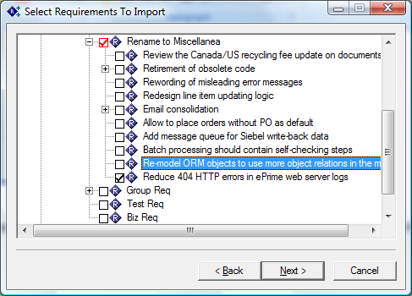
Republish Modified Requirements
Example (a) : to republish a modified reqt that has child requirement(s)
Suppose we need to republish ‘Rename to Miscellanea’
Select ‘Rename to Miscellanea’, then all its child requirements will be selected as default
Deselect all the children and then Select one of them e.g. ‘Reduce 404 HTTP xxxx’. Make sure the child requirement in Caliber is the same as its copy in QC (it is not modified)
The copy of ‘Rename to Miscellanea’ in QC will get updated and the hierarchy and folder in QC will be retained

Slide 50
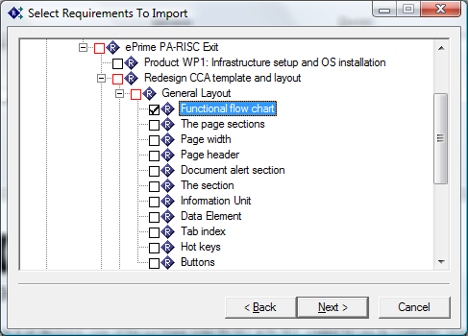
Republish Modified Requirements
Example (b) : to republish a modified reqt that has NO child requirement(s)
Suppose we need to republish ‘Functional flow chart’
Only Select ‘Functional flow chart’
The copy of ‘Functional flow chart’ in QC will get updated and the hierarchy and folder in QC will be retained

Slide 51
Republish Modified Requirements
Click Next
In ‘Connect To QualityCenter/TestDirect’ window, select Host :http://qc1b.atlanta.hp.com/qcbin/
Enter your QC user name and password then click Connect
Select QC Domain PSGIT then select project Tier1
Click Next
Note:
If you are not in the proper QC group with permissions to create/modify requirements you will be told that you don't have permissions to publish.
If you don’t see this QC URL in step 5, please contact your Caliber admin to add it.

Slide 52
Republish Modified Requirements
In ‘Customize Fields’ window, Select force updating fields. Do not select anything else.
Click Next

Slide 53
Republish Modified Requirements
14. If you see a window similar to this that has the word "< Folder >" in it you may ignore this message. Click OK and continue.

Slide 54
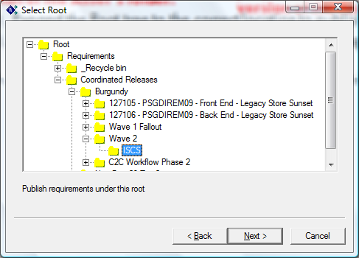
Republish Modified Requirements
Expand the Root tree to the correct location to publish requirements
To find project’s version of the asset’s folder in PSGIT QC: e.g. Go Root →Requirements → Coordinated Releases → Burgundy→127105 Wave 2 →ISCS
Then Highlight the asset folder e.g. ISCS folder, click Next. Make sure to select the same folder in QC that contains the other product requirements for that project.
Since this is republishing modified requirements, you MUST select the same location that was selected last time. If you publish to a different location, you will get unexpected results.
For example, it could happen that the requirements published previously get moved to a new location in QC.

Slide 55
Republish Modified Requirements
When the system is processing the publish request, it could take a lot of time. Since this is not the first time to publish these requirements, they will be marked as “Updated” when they are published successfully.
Please wait until the process is finished, and the ‘Cancel’ button will be changed to ‘Done’, then click ‘Done’. Now we are finished.

Slide 56
Republish Modified Requirements
We have finished the publishing steps in Caliber. Please login to QC and Leave/Make Sure Requirement Type in QC = Undefined, unless a node is not a the lowest level of requirement - then change the requirement type to folder. Due to a limitation in the Borland publishing tool, it is imperative that you do not change the requirement type of the QC requirements that were published from CaliberRM. They must remain as Undefined requirement types. If you change the requirement type in QC, this will cause errors in subsequent attempts to publish requirements from CaliberRM to QC. Once the type is changed, you may not be able to republish the updates successfully.

Slide 57
Republish Modified Requirements
Manually enter/check the following fields in QC per SLIM (see highlighted in red & yellow in next slide)
Check PPM field retained
125663 Customer Master Data Phase 1
124078 ePrime PA-RISC Exit 2
169957 ESD Phase 3A
168504 Public Sector Data Completeness Phase 2
130499 Wave 1 Simple Fallout Project
127105 Wave 2
Check Target Release retained (=Burgundy)
Check Product retained
Check Focus Area: region impact retained
Enter Category again: required for W2-projects only, could be multi-select - because old values will not be retained after re-publishing.
If node is not the lowest level of requirement, then change the requirement type to folder.
Please don’t change other fields, especially the blue fields highlighted in next slides (unless you have to change a reqt type to folder); Kylie & Diana will help to load the yellow fields if you have problems.

Slide 59
Process Approved CR to Remove Requirements

Slide 60
Process Approved CR to Remove Requirements
Please follow the steps according to how you maintain your project requirements
Case A. To remove Caliber-published requirements from QC & Caliber
Caliber-published requirements are created in Caliber, then published into QC. The master requirements are maintained in Caliber. You will remove the QC requirement copies, then mark the Caliber requirements as deferred or rejected.
Please see detailed steps in slides No 55 to 62
Case B. To remove QC-direct-entry requirements from QC (not applicable for Burgundy)
QC-direct-entry requirements are created in QC (not published from Caliber). The master requirements are maintained in QC only.
Please see detailed steps in slides No 55 to 60

Slide 61
Process Approved CR to Remove Requirements Case A & B. To remove QC requirements
Overview
When requirements are deleted from QC it is very difficult and time-consuming to get them restored. A global approach of not allowing anyone permission to delete requirements has been adopted. However, there are recommended best practices to help users "delete" requirements when they are no longer needed in QC.

Slide 62
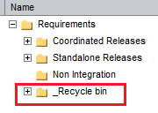
Process Approved CR to Remove Requirements Case A & B. To remove QC requirements
Moving the requirements to a special Recycle Bin location
Use Cut/Paste operations to move the requirements to Recycle Bin folder
You also can do this using QC's Drag and Drop functionality. However, QC occasionally has a problem with Drag and Drop so it's recommended to use Cut/Paste instead.
You MUST understand how the Cut/Paste actions work before proceeding.
When you Cut a requirement and Paste it to another location ALL children of the requirement will be moved along with the one you selected.

Slide 63
Process Approved CR to Remove Requirements Case A & B. To remove QC requirements
Remove test coverage and Requirement Traceability
Change into Requirements Tree View (View → Requirements Tree)
Locate the requirements that you just moved to _Recycle bin.
For each requirement that has a value in the Direct Cover Status field, you must remove the test case(s) and traceability links.
Right-click on the requirement
select Requirement Details (this will open up a new window)
select the Test Coverage icon on the left
remove all tests from coverage
select the Requirements Traceability icon on the left
Remove all traceabilities by right-clicking on the requirement and selecting "Remove from Traceability". Be sure to look in both the Trace To and Trace From sections.

Slide 64
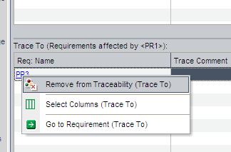
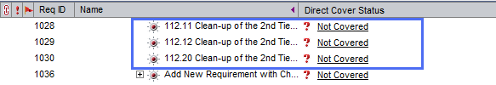
Process Approved CR to Remove Requirements Case A & B. To remove QC requirements
Remove test coverage and Requirement Traceability
When removing traceabilities is done, the requirement should look like this

Slide 65
Process Approved CR to Remove Requirements Case A & B. To remove QC requirements
Remove all the values in the following fields:
PPM
Target Release
Product
Focus Area
Category

Slide 66
Process Approved CR to Remove Requirements Case A only. To remove Caliber requirements
Determine if the CR deletes a) PRs only or b) PRs and BRs
a) PRs only: Go to the Caliber projects for all impacted PRs and perform following steps (coordinate as needed across impacted products)
b) PRs and BRs: Go to the Caliber projects for all impacted PRs and ALSO to the Caliber project for all impacted BRs, and perform following steps (coordinate as needed across impacted products)

Slide 67
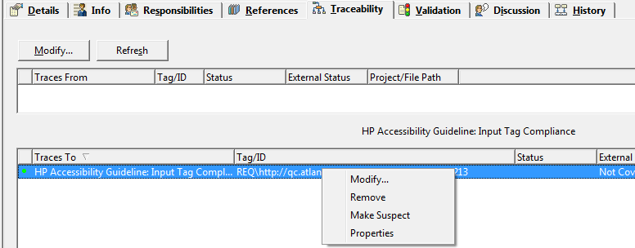
Process Approved CR to Remove Requirements Case A only. To remove Caliber requirements
Login to Caliber and Remove the Caliber Traceabilities
In your Caliber instance, mark the Caliber requirements as deferred or rejected. Then:
Select a requirement and Click on the requirement’s traceability tab.
Right click against the items in Trace From or Trace To then select ‘Remove’. Make sure to remove both Trace From and Trace To.

Slide 68
Process Approved CR to Remove Requirements Case A only. To remove Caliber requirements
You are done!

Slide 69
Backup

Slide 70
Backup
Training slides posted here:
Project Document Library: http://enhanced2.sharepoint.hp.com/teams/WWECOReleaseMgt/Burgundy/Project%20Documentation/Forms/AllItems.aspx
File Link:
http://enhanced2.sharepoint.hp.com/teams/WWECOReleaseMgt/Burgundy/Project%20Documentation/Publish%20Requirements%20from%20Caliber%20to%20QC%20and%20Instructions%20for%20Change%20Request%20final.pptx

